Slide 1

Food Management System
Team Members:
SUJITH SAIRAM M 20CS148
VISHNUPRABHU R 20CS170
VIGNESHWARAN R 20CS164
VARUNPRASATH M 20CS158
Guided by:
Mr.R.Giridharan

Slide 2
Outline:
INTRODUCTION
OBJECTIVE OF THE SYSTEM
EXISTING SCENARIO
PROPOSED SOLUTION
BLOCK DIAGRAM
PHOTO COPIES
CONCLUSION

Slide 3
INTRODUCTION:
This website is purely based on the concept of Ordering foods and reserving tables.
The reservation can only done at a particular time.
It will be a user friendly application.

Slide 4
OBJECTIVE:
The main objective of the Online Food Reserving System is to manage the details of Item Category,Food,Delivery Address,Order and reserving tables.
Costumers time can be saved.
Total food ordered can be viewed by the executive chef so that amount of food can also be saved due to this web application.

Slide 5
EXISTING SCENARIO
As a restaurateur,you might be worried about stuff challenges.Impatient and cautious dine-in customers don’t prefer to wait in long queues anymore.
Reservation management systems makes food ordering and reserving tables easy.

Slide 6
PROPOSED SOLUTION
To overcome this , our website will be very useful as customers can reserve their table earlier ,so they need not to stand in a queue or either they can't waste their time
It helps restaurants to estimate demand in a more accurate way, and therefore, to improve sourcing and staffing, and to manage costs more efficiently. By managing workflow in a better way, through reservations, the restaurant will be able to deliver a better quality of service.

Slide 7
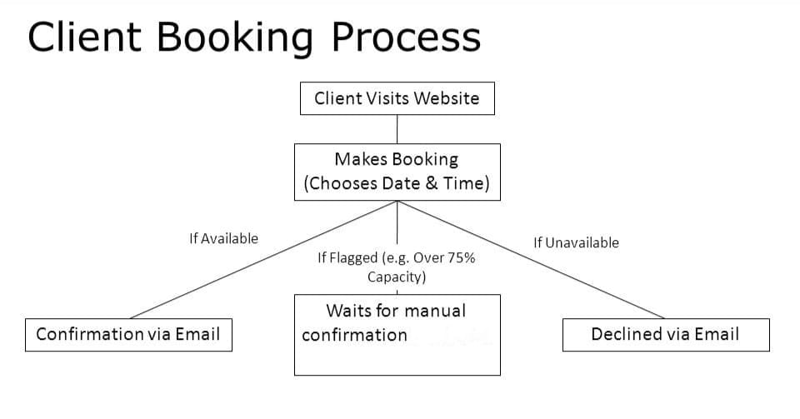
BLOCK DIAGRAM:

Slide 8
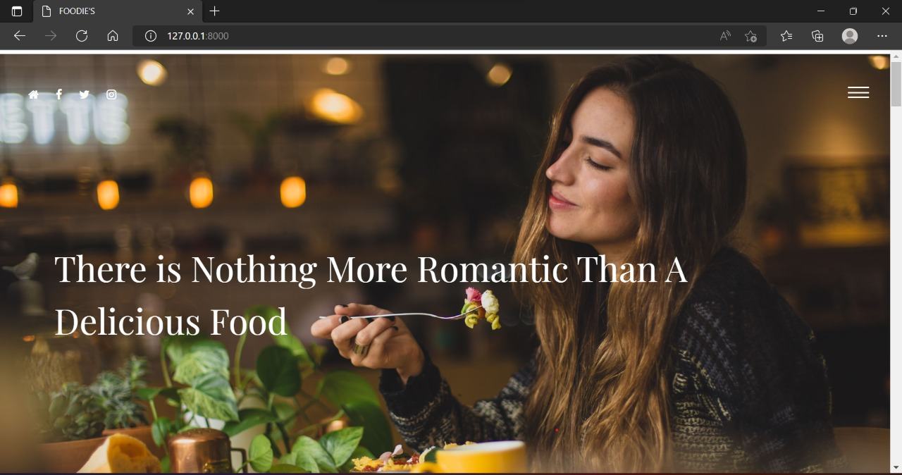
Photographs of the Project: Home page:

Slide 9
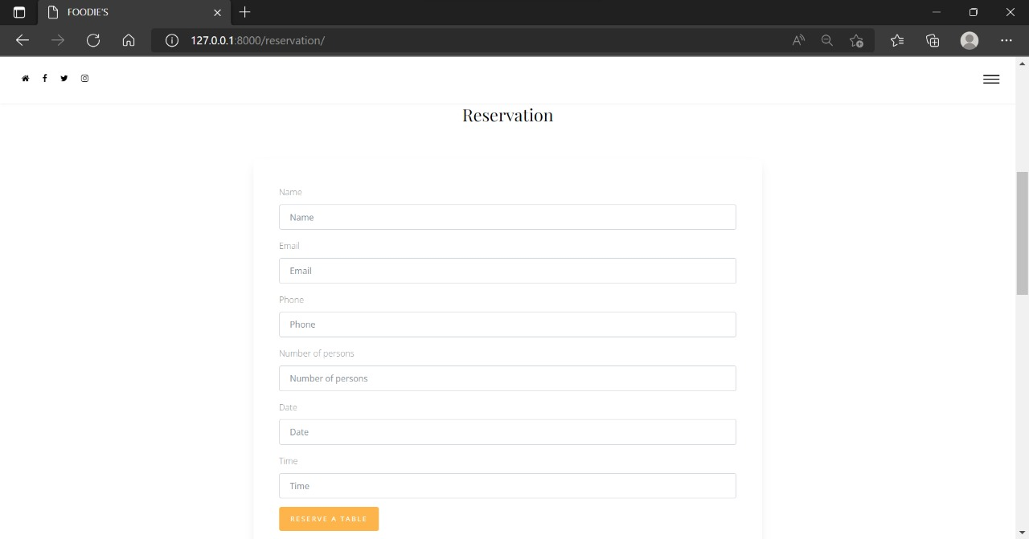
Resertion Page:

Slide 10
THANK YOU

